Slide 1
Popular Song Sentiment vs Global Sentiment
Blue Homework Team 17
Feliciti Milne
Noah Johnson
Patrick O’Keefe
Josh Hull
Jiwon Lee

Slide 2
Art does not imitate life
Sentiment metrics had a -0.525
correlation coefficient with GS Indicator
Notes:
Art does not imitate life …. at least not how you would expect it

Slide 3
Table of contents
01
02
03
Background
Text Analysis
Sentiment Analysis

Slide 4
01
Background
Background
Text Analysis
Sentiment Analysis
Conclusion

Slide 5
Methodology
Data Source
Data Cleaning
Sentiment Analysis
Lyrics from Genius.com API
Remove stop words
Identify foreign words &
non-traditional words
NLTK VADER Polarity Score
NRCLex Emotional Affects
Background
Text Analysis
Sentiment Analysis
Conclusion

Slide 6
02
Text Analysis
Background
Text Analysis
Sentiment Analysis
Conclusion

Slide 7
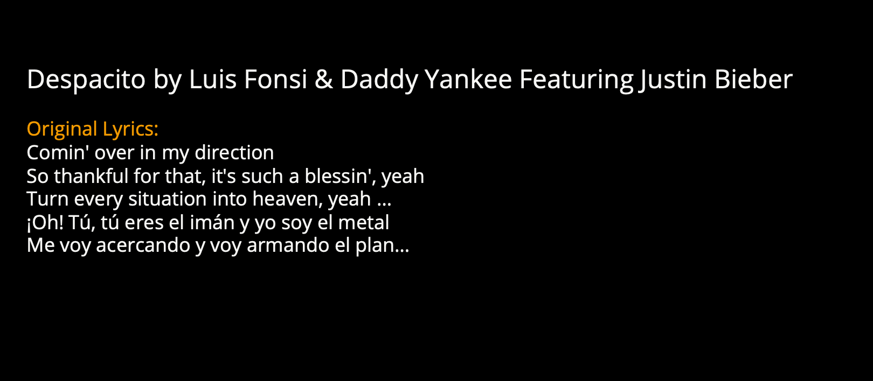
Example Process
Background
Text Analysis
Sentiment Analysis
Conclusion

Slide 8
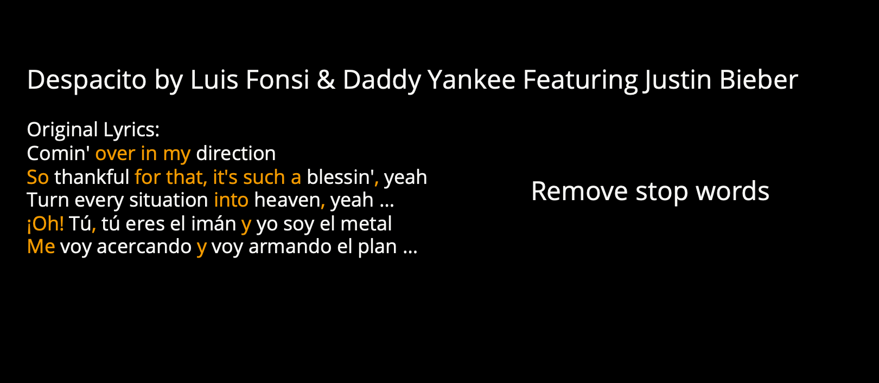
Example Process
Background
Text Analysis
Sentiment Analysis
Conclusion

Slide 9
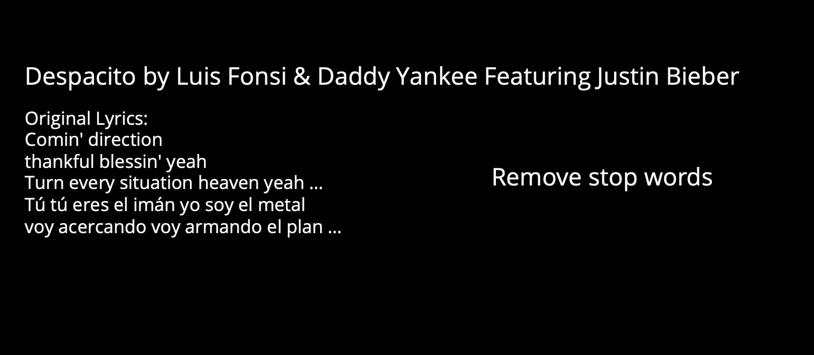
Example Process
Background
Text Analysis
Sentiment Analysis
Conclusion

Slide 10
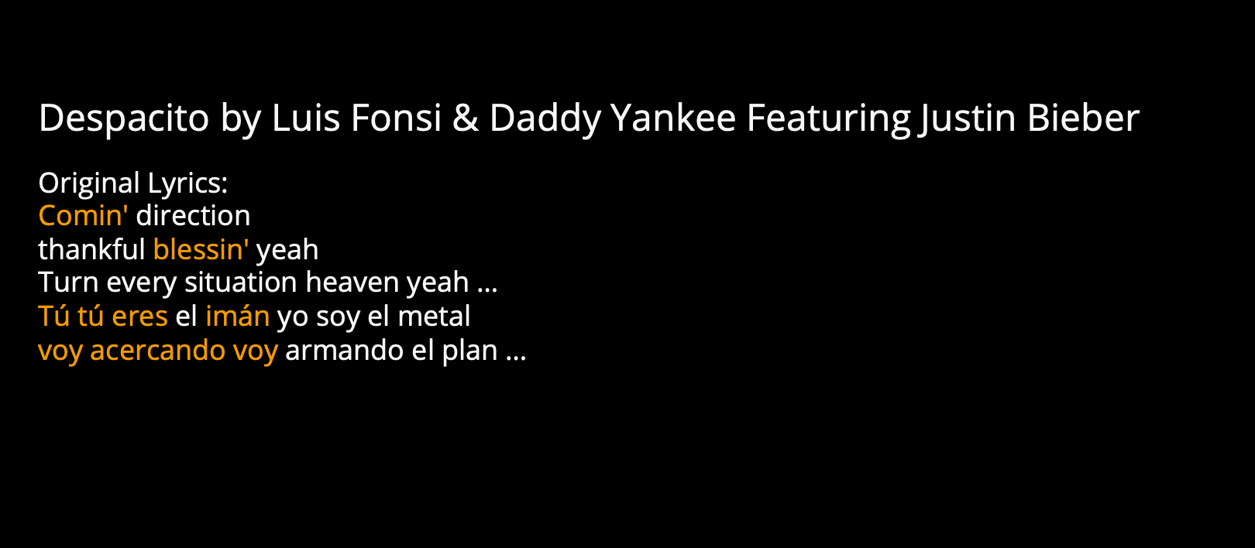

Example Process
Background
Text Analysis
Sentiment Analysis
Conclusion

Slide 11
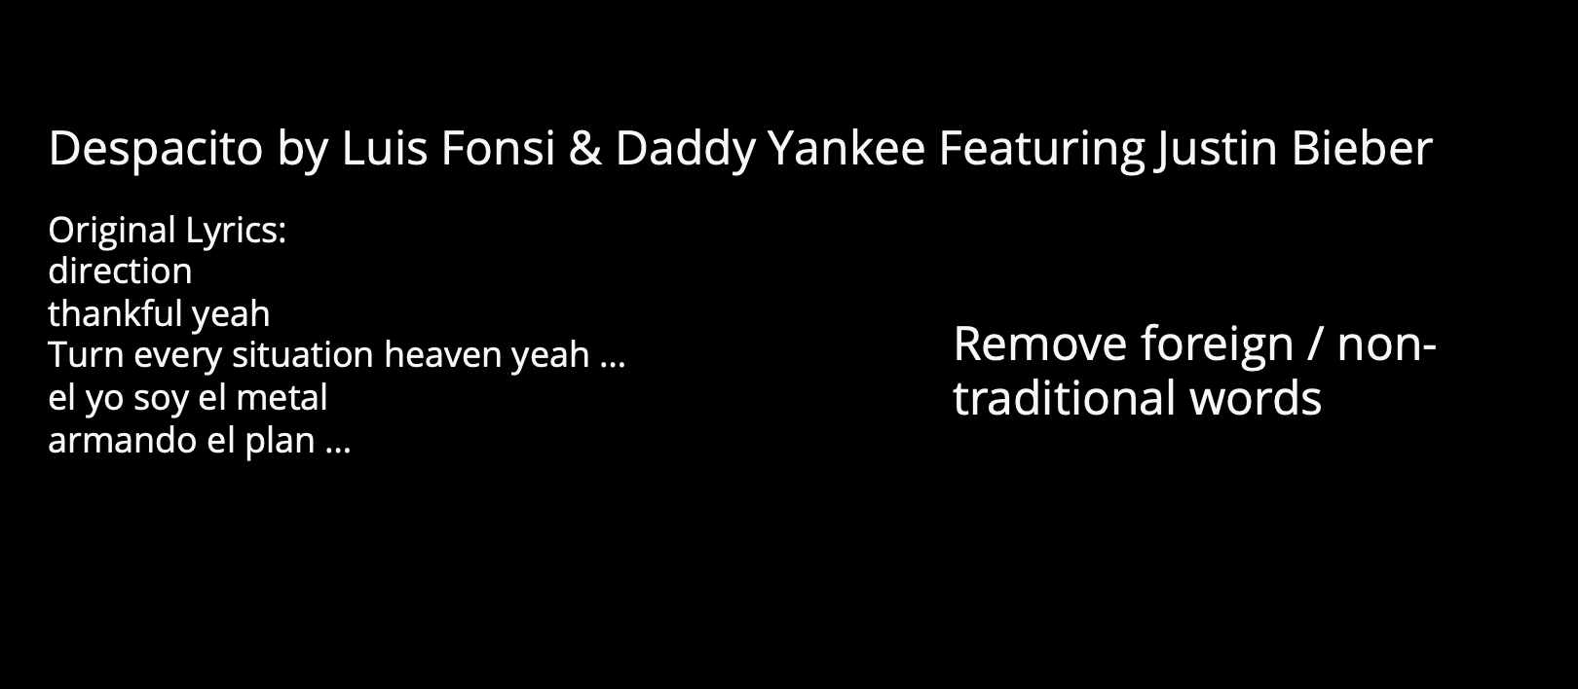
Example Process
Background
Text Analysis
Sentiment Analysis
Conclusion

Slide 12
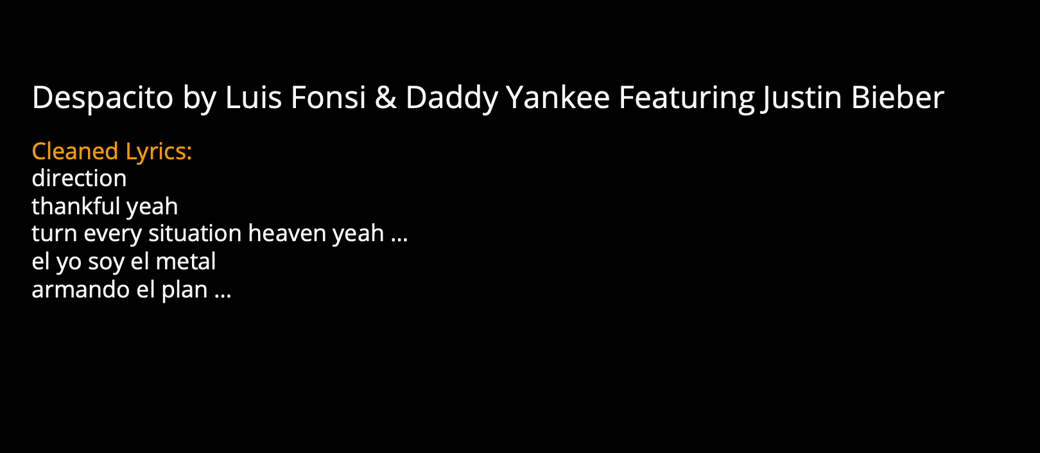
Example Process
Background
Text Analysis
Sentiment Analysis
Conclusion

Slide 13
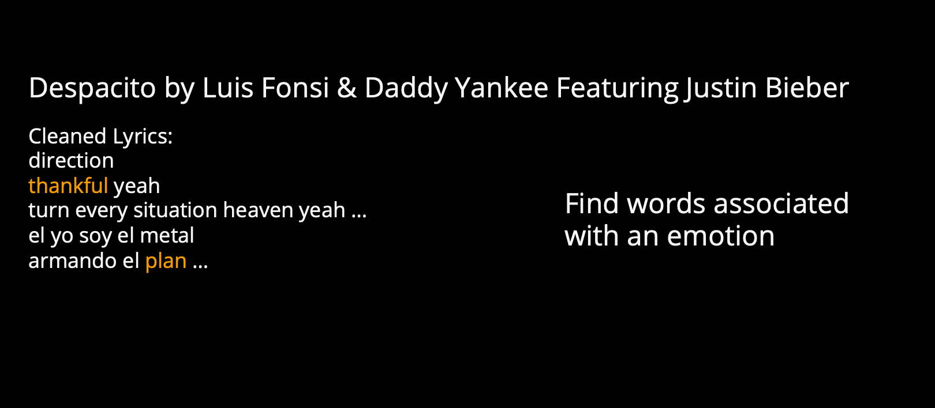
Example Process
Background
Text Analysis
Sentiment Analysis
Conclusion

Slide 14
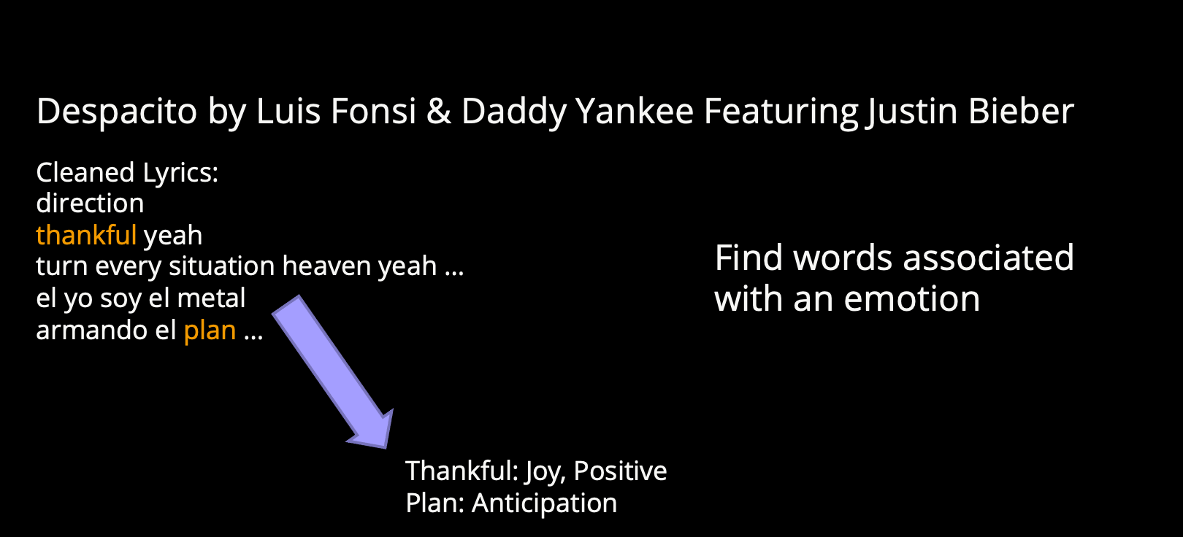
Example Process
Background
Text Analysis
Sentiment Analysis
Conclusion

Slide 15
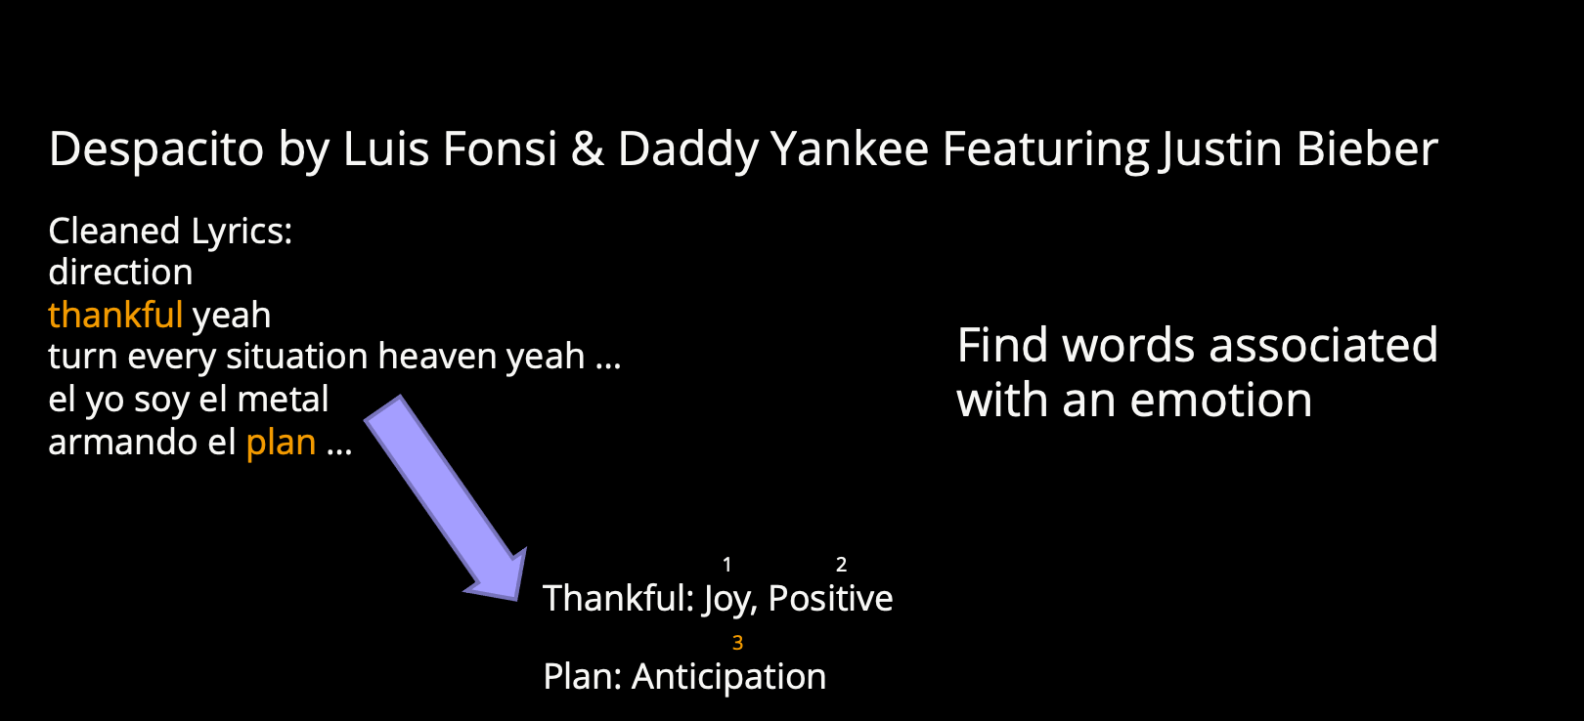
Example Process
Background
Text Analysis
Sentiment Analysis
Conclusion

Slide 16
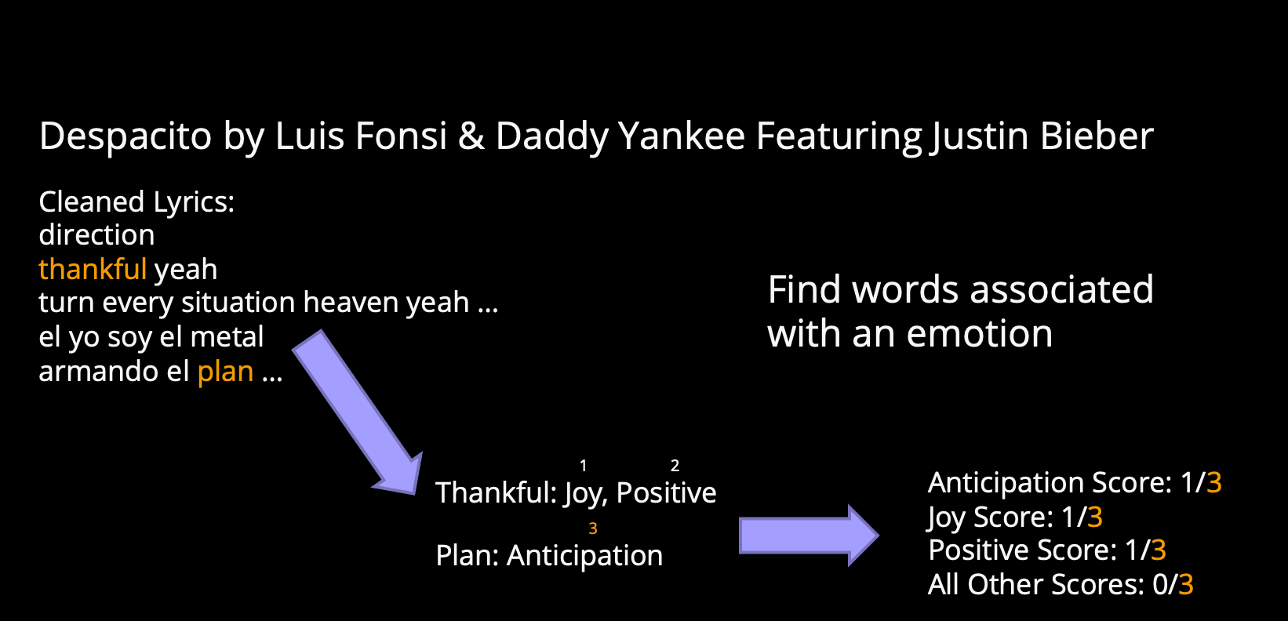
Example Process
Background
Text Analysis
Sentiment Analysis
Conclusion

Slide 17
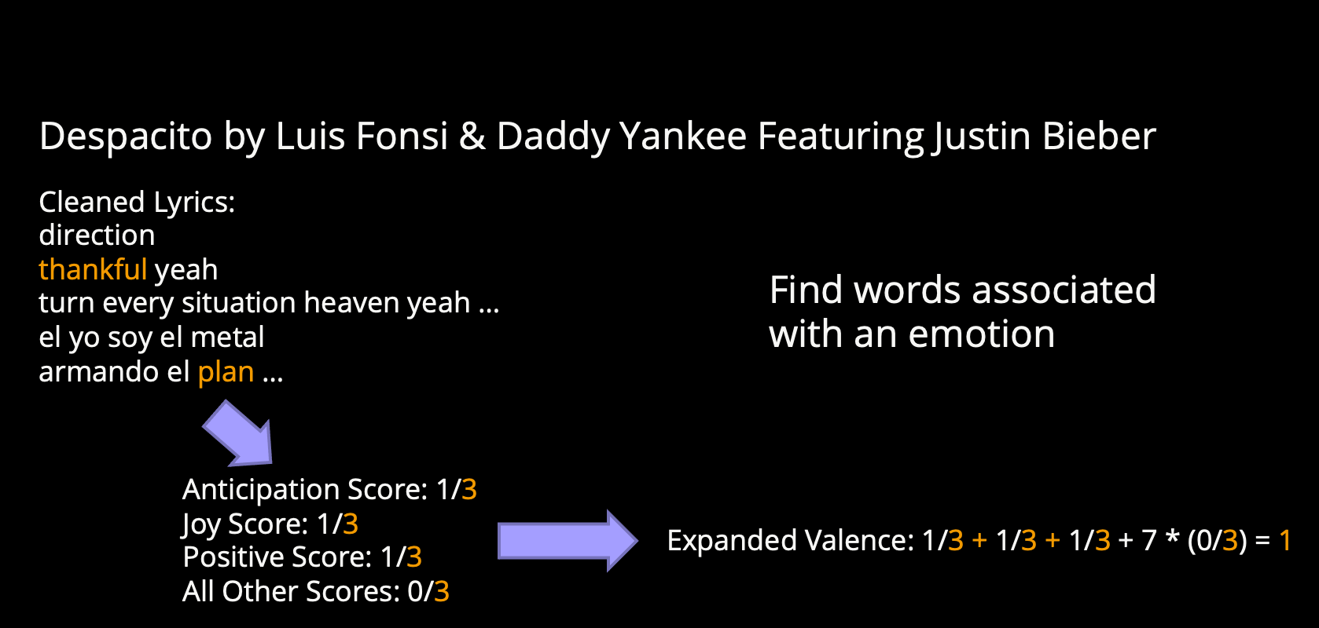
Example Process
Background
Text Analysis
Sentiment Analysis
Conclusion

Slide 18
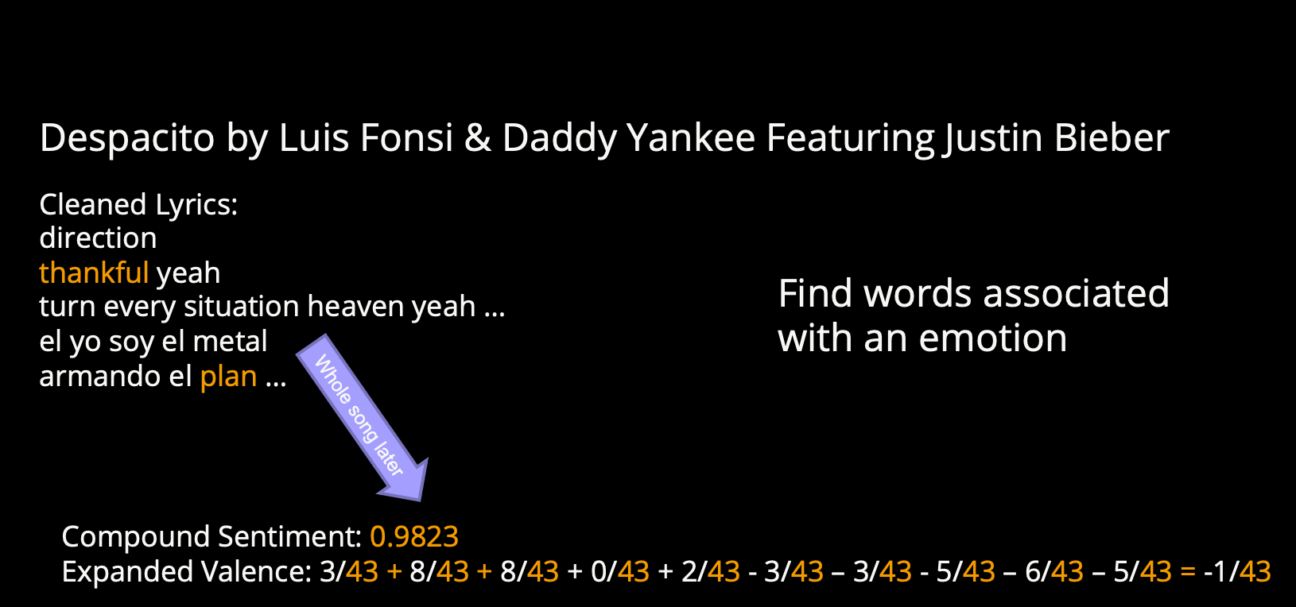
Example Process
Background
Text Analysis
Sentiment Analysis
Conclusion

Slide 19
03
Sentiment Analysis
Background
Text Analysis
Sentiment Analysis
Conclusion

Slide 20
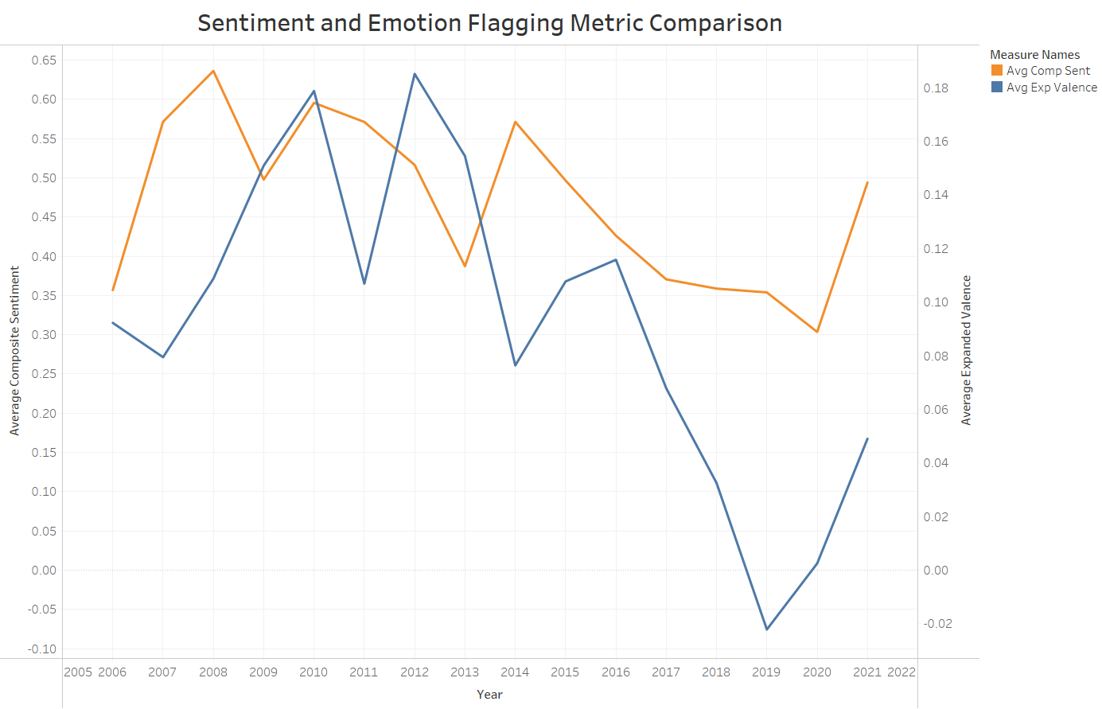
Background
Text Analysis
Sentiment Analysis
Conclusion
Notes:
Performed sentiment on the left axis and orange and emotional analysis on the right and blue
Numbers = average sentiment and expanded valence each year since 2006

Slide 21
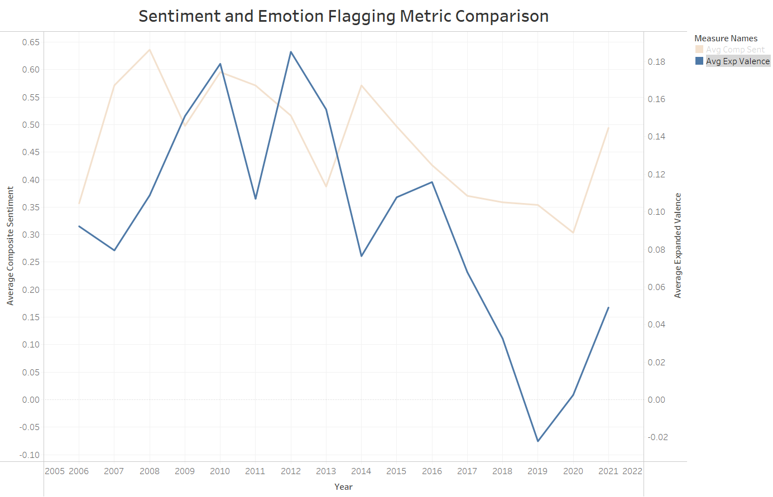
Background
Text Analysis
Sentiment Analysis
Conclusion
Notes:
Expanded valence represents emotion
This is difficult to be interpreted in songs due to the amount of underlying context conveyed
Therefore, we focused specifically on sentiment due to its simpler calculation

Slide 22
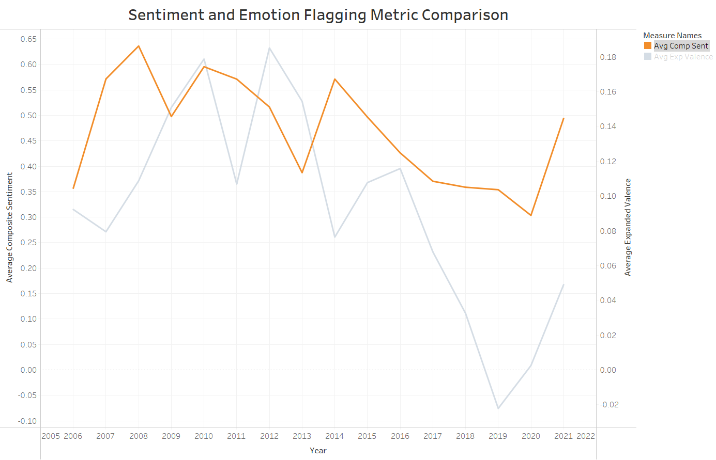
Background
Text Analysis
Sentiment Analysis
Conclusion
Notes:
Sentiment analysis each year

Slide 23



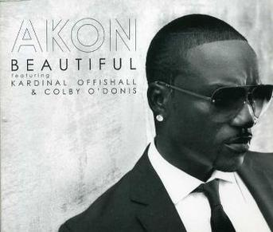


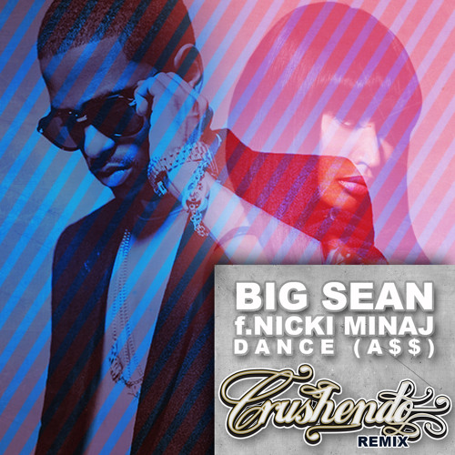

Most Polarized Song of the Year
‘06
One Wish
Ray J
0.9999
‘07
Party like a
Rockstar
Shop Boyz
0.9999
‘08
Lollipop
Lil Wayne /
Static Major
0.9997
‘09
Beautiful
Akon
0.9998
‘10
Your Love
Nicki Minaj
0.9998
‘11
Cheers
(Drink to That)
Rihanna
0.9998
‘12
Dance (A$$)
Big Sean /
Nicki Minaj
-0.9999
‘13
Diamonds
Rihanna
0.9998
Background
Text Analysis
Sentiment Analysis
Conclusion
Notes:
06 = positive
12 = Negative
4 out of the past 16 years have had negative sentiment

Slide 24

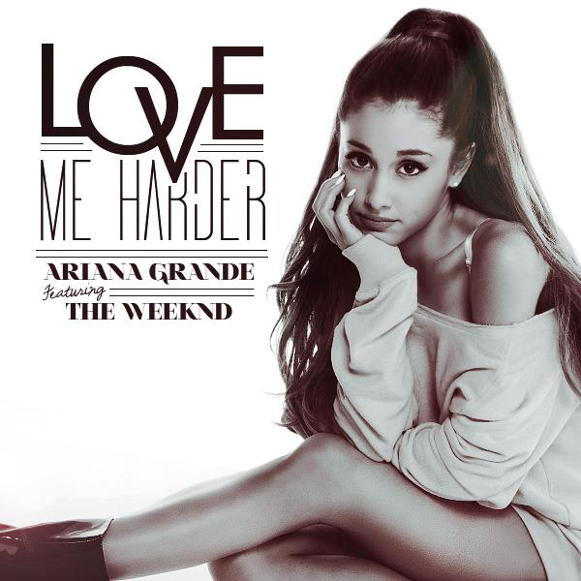
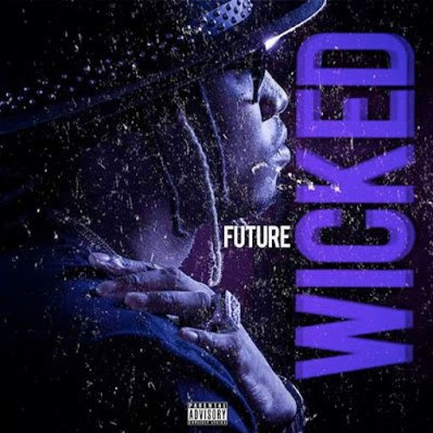
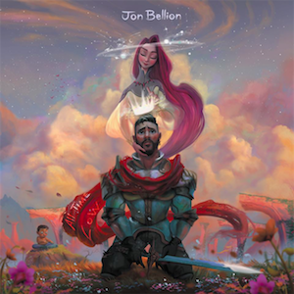
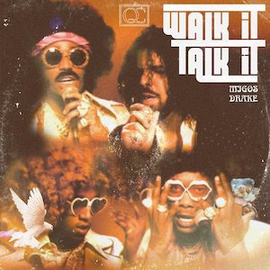

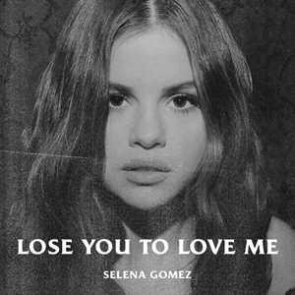

Most Polarized Song of the Year
‘14
Happy
Pharrell Williams
0.9996
‘15
Love Me Harder
Ariana Grande /
The Weeknd
0.9995
‘16
Wicked
Future
-0.9998
‘17
All Time Low
Jon Bellion
-0.998
‘18
Walk It Talk It
Migos / Drake
0.9998
‘19
Murder on My Mind
YNW Melly
-0.9997
‘20
Lose You to Love Me
Selena Gomez
0.9997
‘21
Way 2 Sexy
Drake / Future / Young Thug
0.9997
Background
Text Analysis
Sentiment Analysis
Conclusion
Notes:
16 17 19 = negative

Slide 25
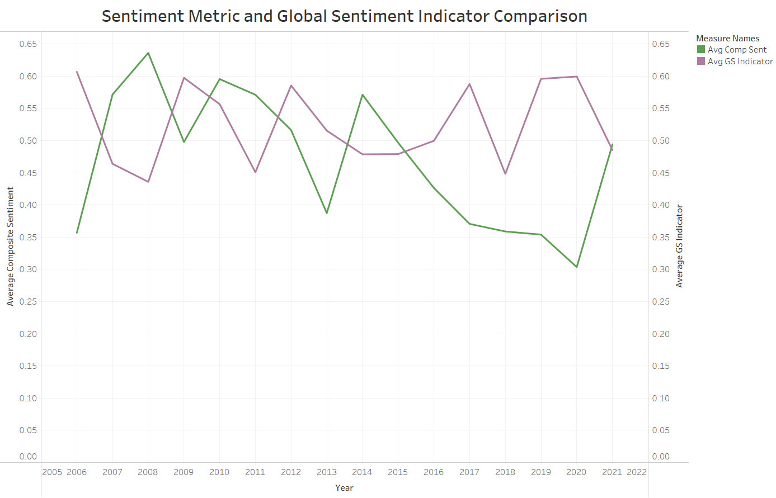
Background
Text Analysis
Sentiment Analysis
Conclusion
Notes:
Average sentiment in green
Average global sentiment indicator in purple

Slide 26
04
Conclusion
Background
Text Analysis
Sentiment Analysis
Conclusion

Slide 27
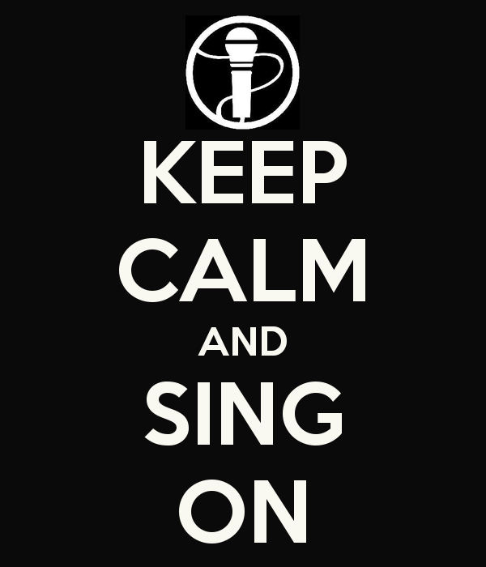
Negative correlation between global market indicator and compound song sentiment
Next Steps
More genres of music
More granular data
Background
Text Analysis
Sentiment Analysis
Conclusion
Notes:
Regarding first bullet point → Song sentiment as a leading indicator of global sentiment?
Topic modeling
Different genres

Slide 28
Thanks!
Does anyone have any questions?

Slide 29
Appendix
Background
Text Analysis
Sentiment Analysis
Conclusion

Slide 30
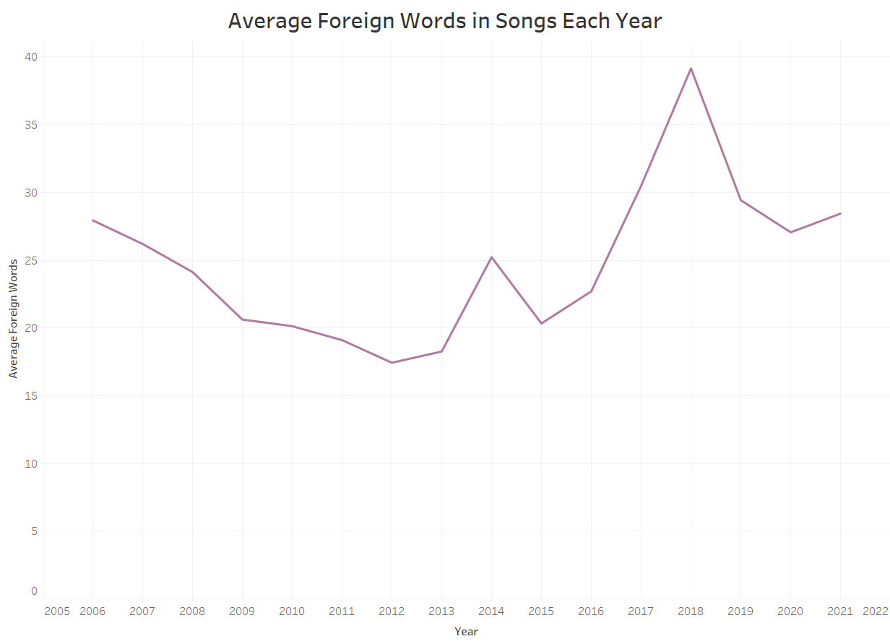

Slide 31
